Slide 1
Lightning Talk 2
sdmay21-39

Slide 2
Technical goals - Backend Interface Jet J.
Ease of use vs longevity
React Frontend
Communicate with orchestrator

Slide 3
Backend Orchestrator
Adis Osmankic
Ansible
Lab management
Communicate with multiple cloud platforms
Configure labs
Notes:
For the backend, we want to have an orchestrator that will deploy the lab environments to whatever platform is needed. A main requirement of this project is to have labs that can be deployed to the cloud, so we needed to find a suitable method to create, manage, and deploy to the cloud. With this in mind, we decided to go with ansible as our orchestrator. Ansible is an agentless automation tool that will allow for us to automate cloud Virtual Machine deployments and create networks that allow for individual machines to communicate with each other in one environment. The goal with Ansible is to manage these labs that will be deployed and it allows us to do this by creating automation scripts that can deploy a lab to the cloud automatically, which is a large part of this project. The project also needs the labs to be highly configurable and Ansible allows for a large amount of customization in creating Virtual Machines and a nearly no limits in choosing pre made virtual machines. Possibly one of the most important reasons to use Ansible is the modularity. Modularity is critical for this project. We need to be able to deploy to anywhere from anywhere, and ansible allows us to do this with its convienent hooks into many different platforms, such as Google cloud, AWS, Azure, and on premises nodes.

Slide 4
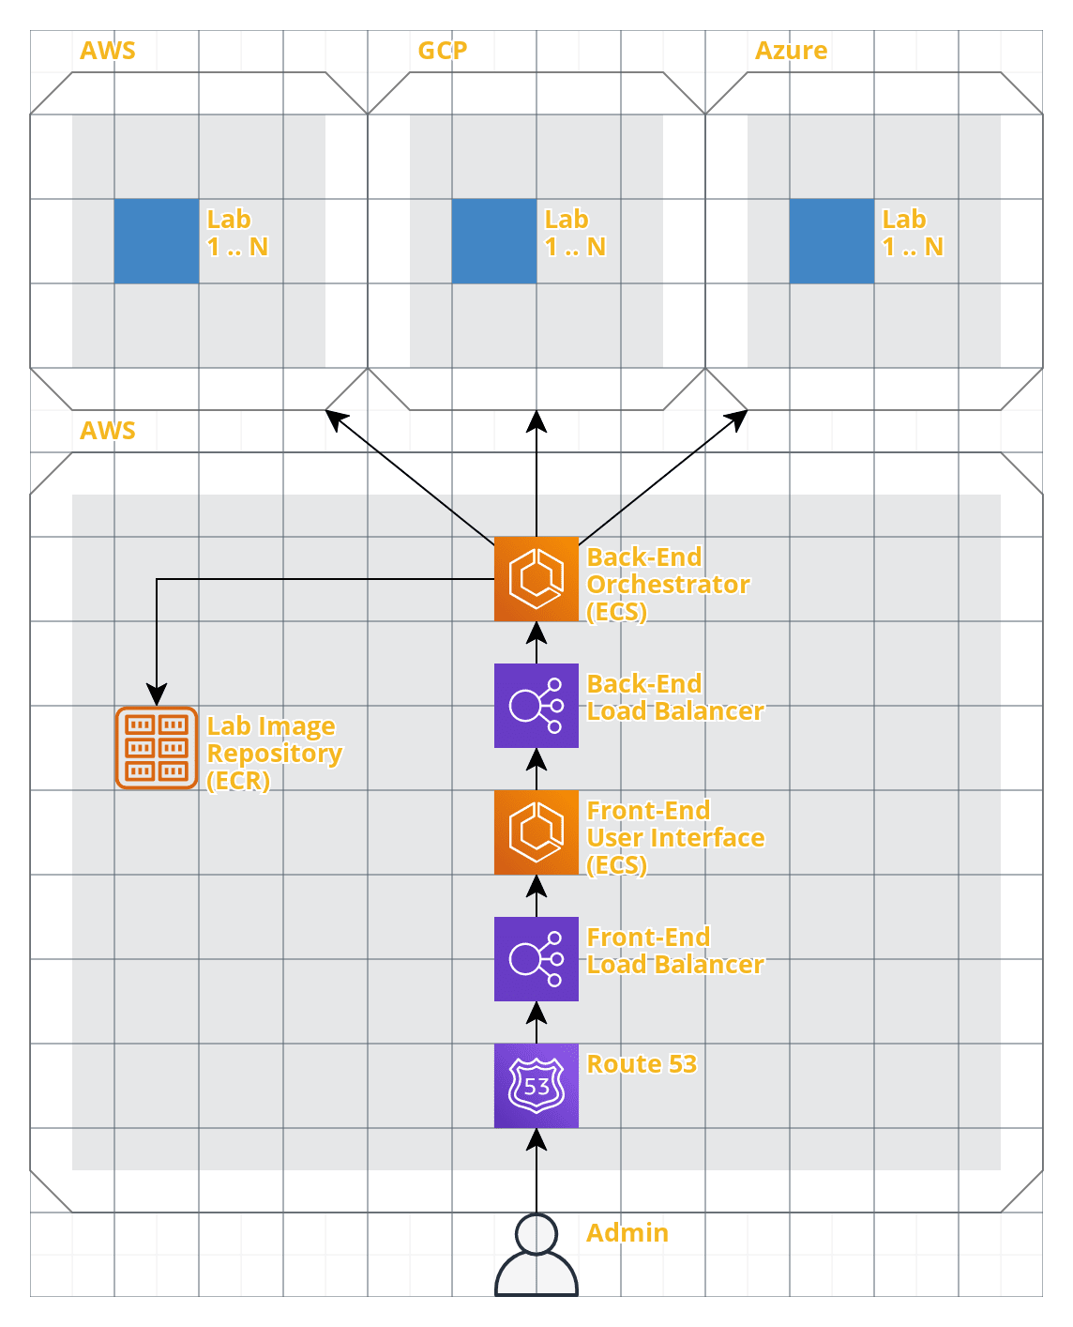
Conceptual Sketch
Zane Seuser
Notes:
So, this is the conceptual sketch of our overall architecture. At the bottom, you can see the admin or user of our application. Working up, the user will be interacting with the front end user interface via Route 53 and the front-end load balancer. Route 53 is an extremely reliable and cost effective way to route our users to our front end application. The load balancer is for ensuring that our application will effectively balance demands of the users across our provisioned resources. Both the front-end and back-end are going to be running on ECS, which is Amazon’s docker hosting service. The back-end service also has a load balancer for the same reason as the front-end. The back-end will be pulling the images for the different labs and platforms from ECR, which is being used to host our lab images. The back-end service will be integrated with Ansible which is is an open-source automation tool used for tasks such as configuration management, application deployment, intraservice orchestration, and provisioning. Using Ansible within our back-end service will make it easy to provision the lab environments within the different cloud platforms such as AWS, GCP, and Azure at the top of the diagram.

Slide 5
Timeline
Gavin Monroe
October milestones consist of research and project planning for the coming up demo at the end of the semester.
November milestones consist of demo development and proof of concept to showcase what we can do before next semester starts.
Notes:
The timeline overall presents a month by month plan, allowing for change by meeting basis if needed. The month of October will be dedicated to getting the required knowledge base of spinning up EC2 servers, and other notable knowledge of cloud platforms. Continuing into the next month, November, the plan would be getting a working demo by developing a product for spinning up and configuring EC2 servers in the AWS platform. These timelines can of course change depending on what will happen by weekly meetings.

Slide 6
Thank you
Cloud Environment Manager

